Slide 1
IBM
FULL STACK WEB DEVELOPMENT PROJECT
Garage24X7
Website for Car Services And Repair
Made by : ISHAAN GUPTA
Course/Branch : B.Tech (IT)
Enrollment no : 05715603120

Slide 2
CONTENT
WHAT IS WEB DEVELOPMENT.
FRONTEND WEB DEVELOPMENT.
BACKEND WEB DEVELOPMENT.
DESCRIPTION OF THE PROJECT.
COMPONENTS OF THE PROJECT.

Slide 3
: WEB DEVELOPMENT :
Web development is the act of building, creating and maintaining websites. The field encompasses a broad range of tasks that include everything from coding to the technical design to the performance of a website or application running on the internet.
Web development consists of front-end and back-end components:
Front-end development consists of the user interface and the look and feel of the website or application.
Back-end development consists of the databases, logic, APIs, servers and everything else that powers the website behind the scenes.

Slide 4


FRONTEND WEB DEVELOPMENT
FRONTEND WEB DEVELOPMENT IS USED TO DESIGN THE LAYOUT AND DESIGN OF ANY WEBPAGE.
TECHNOLOGIES USED IN FRONTEND WEB DEVELOPMENT ARE:
HTML
CSS
JAVASCRIPT

Slide 5

BACKEND WEB DEVELOPMENT
Back-end development means working on server-side software, which focuses on everything you can’t see on a website. Back-end developers ensure the website performs correctly, focusing on databases, back-end logic, application programming interface (APIs), architecture, and servers.
Databases like : MySql , MongoDb etc.

Slide 6
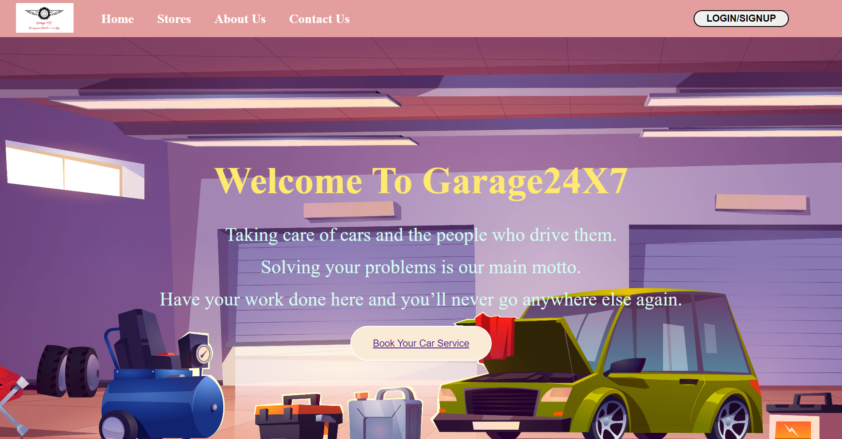
DESCRIPTION OF THE PROJECT
GARAGE24X7 IS AN INDIAN WEBSITE FOR THE CARS . THIS PROJECT IS ALL ABOUT THE GARAGE SYSTEM OF VECHILES IN INDIA . IN THIS , WE HAVE SERVICES OF CAR REPAIRING , CARS REVIEWS , CAR PARTS ETC . THE FRONTEND OF THE PROJECT IS MADE BY USING HTML , CSS AND JAVASCRIPT . THE BACKEND DATABASE IS MONGODB .

Slide 7
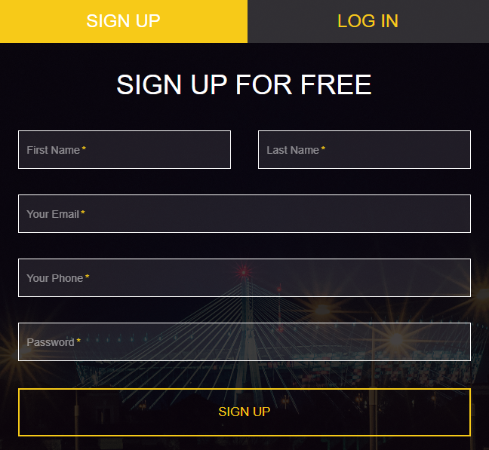
COMPONENTS OF THE PROJECT
LOGIN AND SIGNUP PAGE
In this client have to first signup with his/her details and have to make a account in our database with a proper username and password and after login with his/her details they can access our services like Booking car service , Reviewing Cars etc.

Slide 8
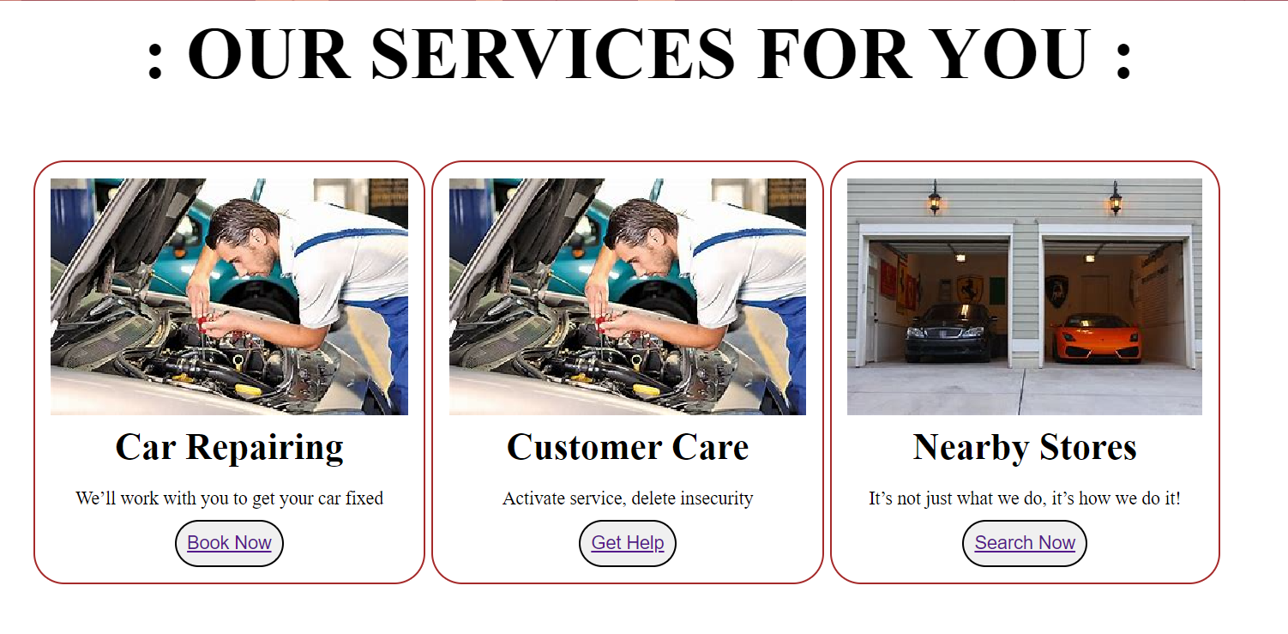
Working : First the data of the user during signup time is inserted into the mongodb database using nodejs and mongodb connectivity . And during login time if the details of the user is present in the database then only he can login into our website and get redirected to our home page to access all services provided by GARAGE24X7.

Slide 9
Booking Car Service
In this client have to fill up the details related to the Car Service Like Date Of Service , Time Of Service , Car Name , Car Type , Car Number , Model , Type Of Service he/she want , Customer Information etc. .and after that his/her service slot will be booked and they get a proper details of time and date of the service of their car.

Slide 10
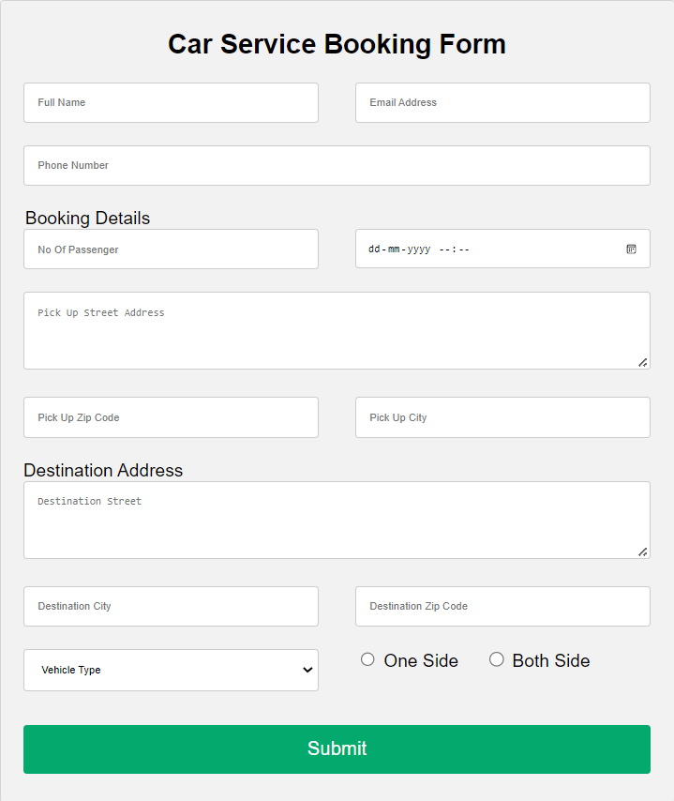

Slide 11
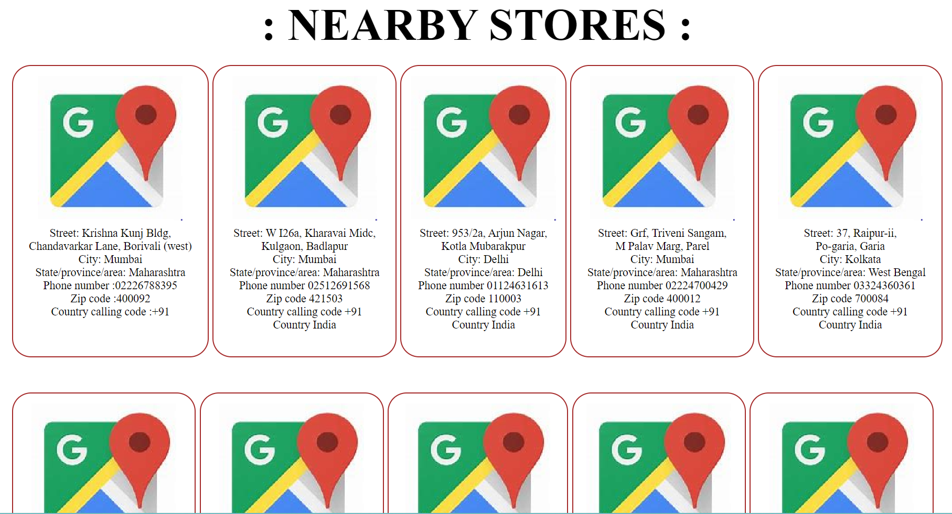
Check Out Nearby Stores
Client can check out the nearby store on which they have to go for they car service on that date and time and get their car serviced .
Working : to show different different stores we have used flexbox in CSS by which all the elements got align horizontally .

Slide 12
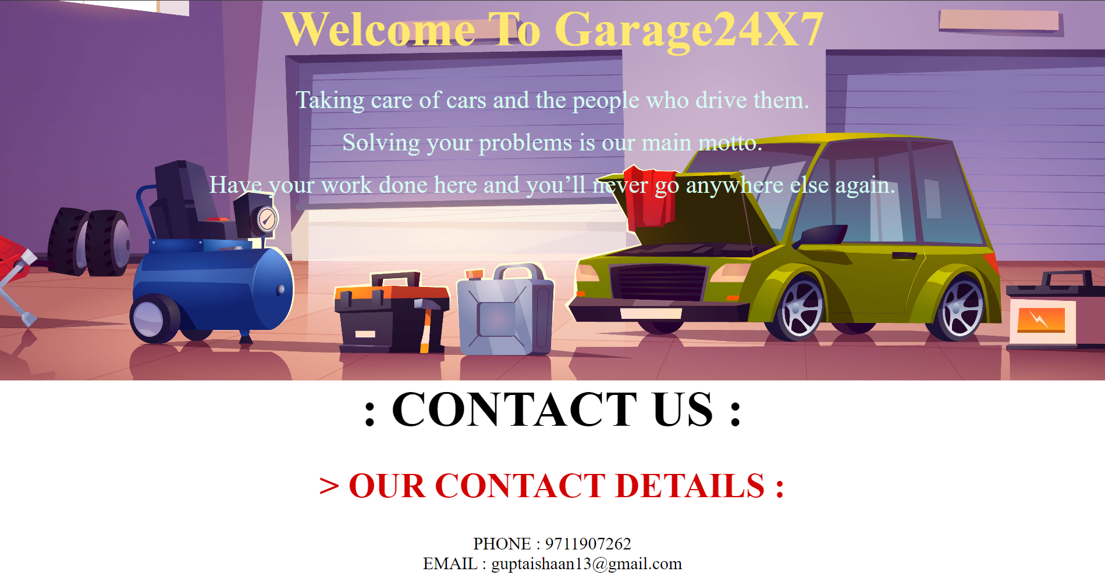
Customer Care
Here , Client can contact our customer care service for any query , any complaint or they want to give some feedback for our company .
Working: in this anchor tag of type email and phone is used so that it can automatically redirected to email and phone services .

Slide 13


